Slide 1
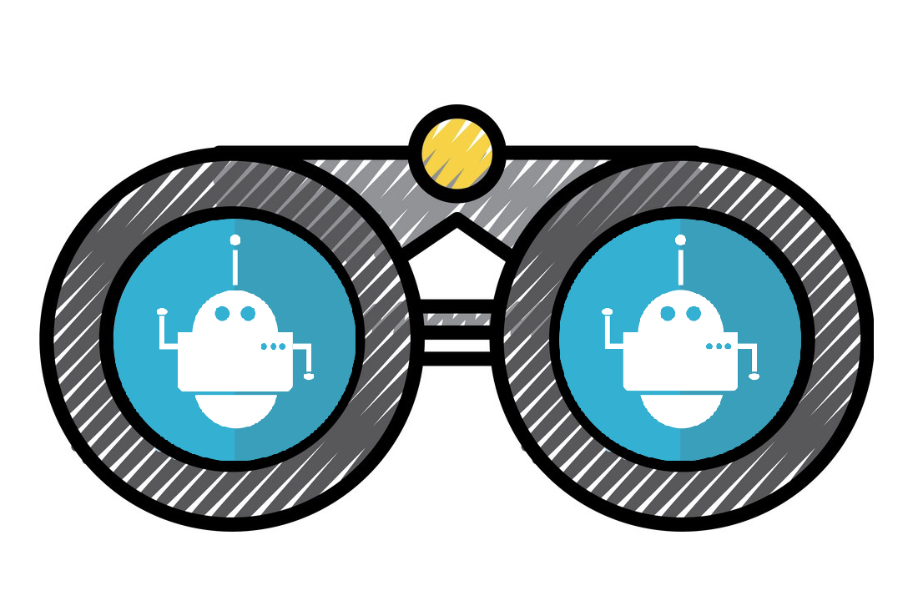
Data Scrap Bot
A tool intended to facilitate research.
By:Jordan Winkler, Edwin Perez, Joseph Venanzio

Slide 2
Inspiration
The inspiration of this project came from wasting too much time manually looking up information for research.

Slide 3

Challenges
Communication
Schedule coordination
Learning time
Debugging
Life

Slide 4
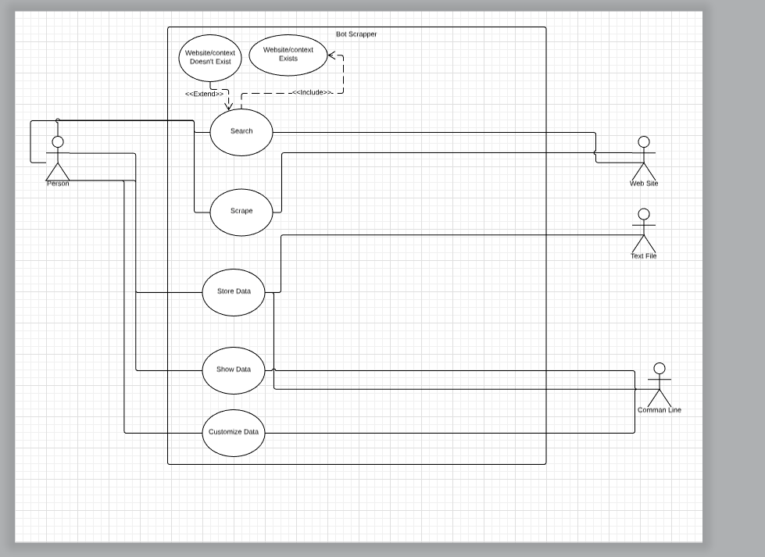
Overview of System
The system remained the same as our initial design, although for our exterior entity of the website, it is limited to sites such as Wikipedia or sites with mostly html tags.

Slide 5
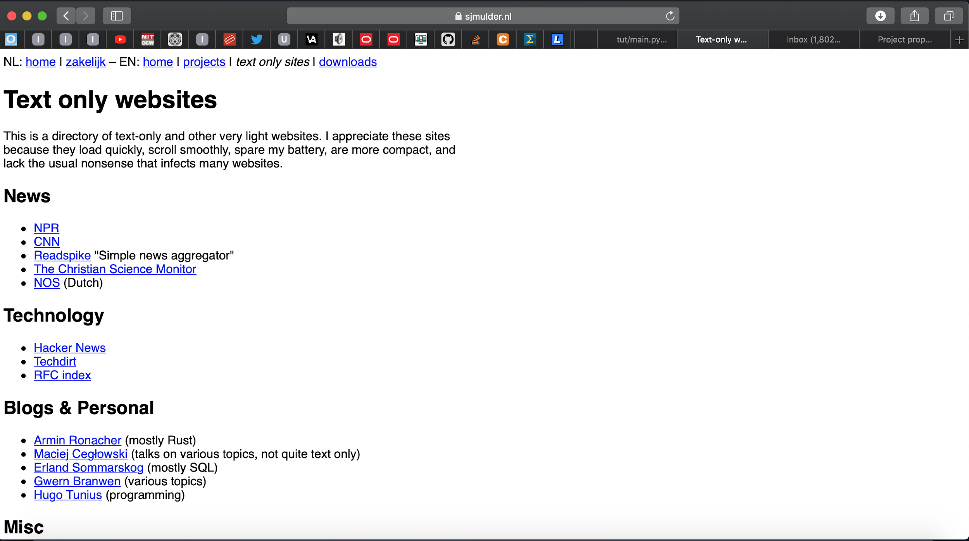
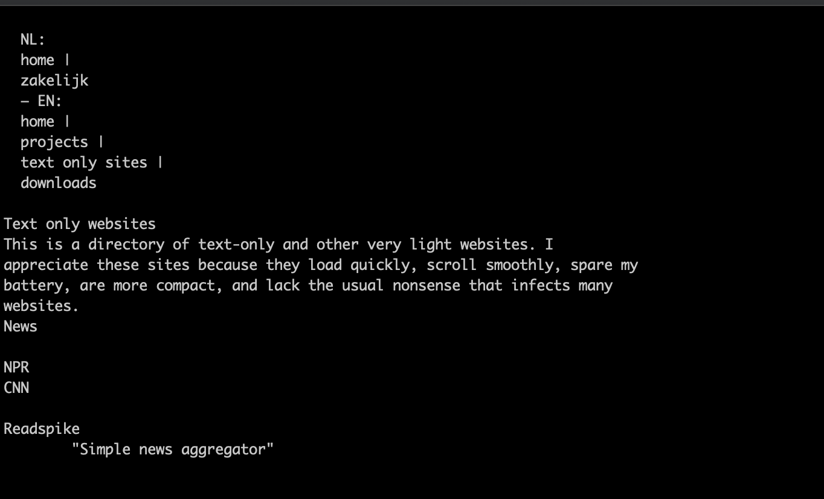
Example

Slide 6
Who
Who can use it:
Anyone with an internet connection and a linux terminal.
Who would it be useful for:
Programmers
Students
Researchers

Slide 7

Tools We Used
Hardware
Anything that runs python
Internet Assessors
Languages
Python 3
Software
Command Line Interface
YouTube
GitHub
Stack Exchange

Slide 8

Future Improvements
In Wikipedia:
Margin where to look
Remove more non-html tags
In General:
Add data amount limit
Add data type choice

Slide 9
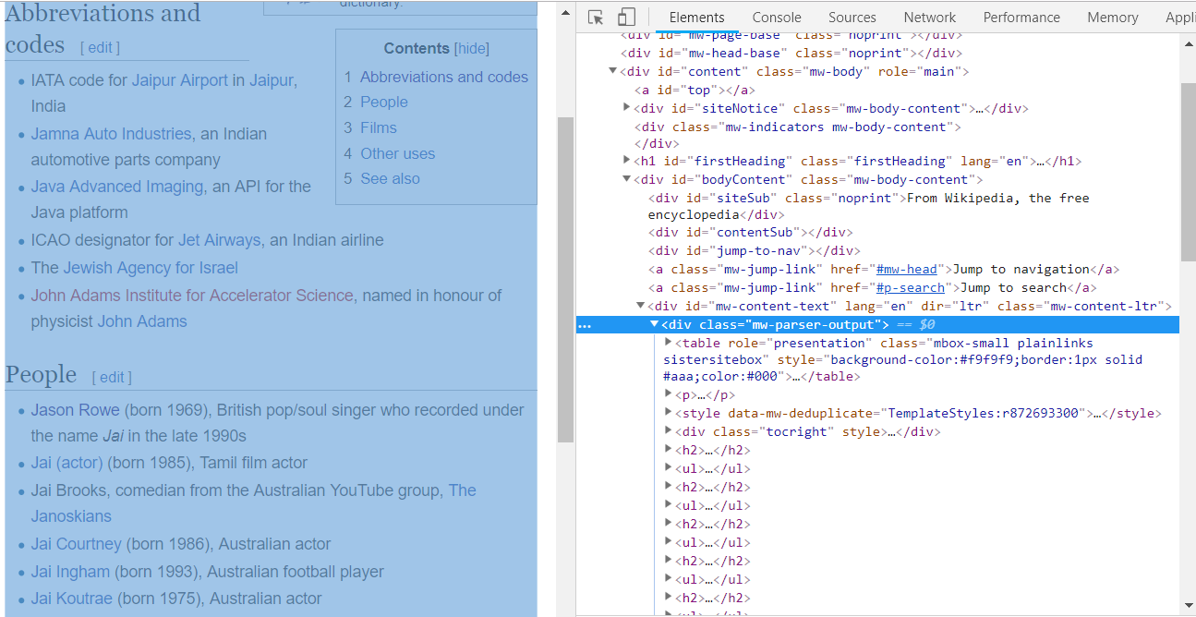
Wikipedia

Slide 10
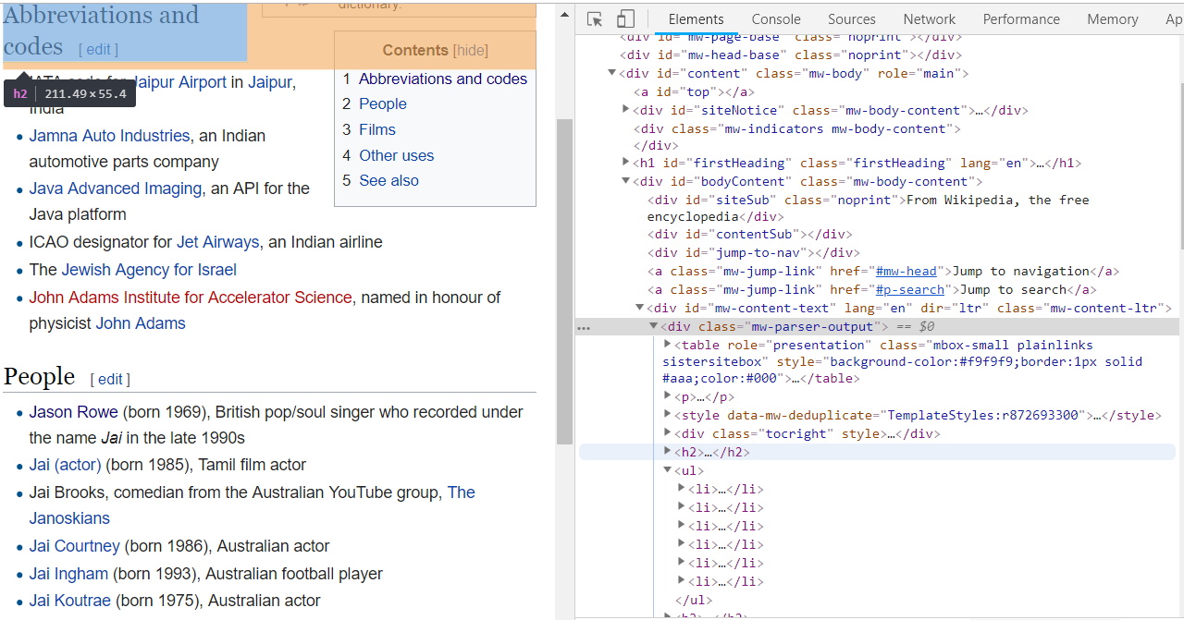

Slide 11
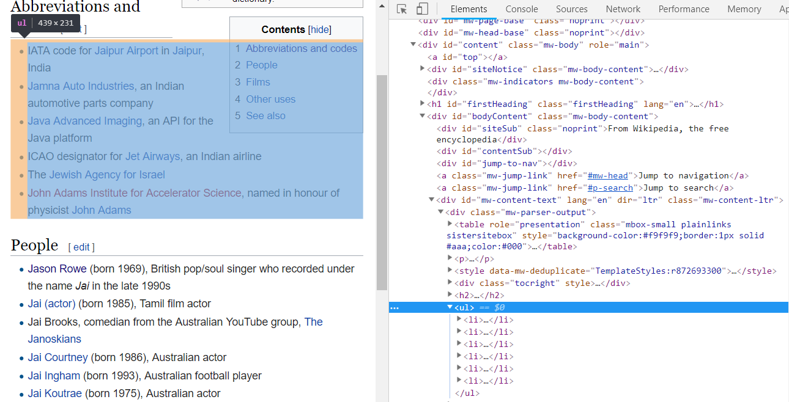

Slide 12

Final Limitations
Needs internet
HTML limited clean-up
Console program

